Slide 1
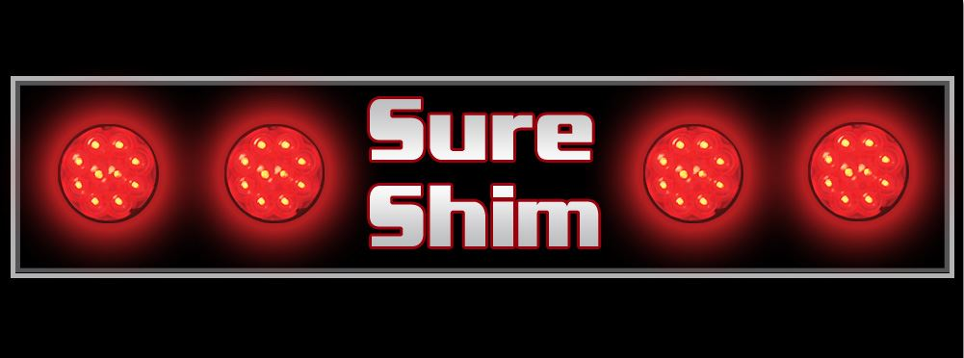

Slide 2
Federal Motor Carrier Safety Regulations require that all lights work at all times
  It is NOT a matter of convenience
  It is NOT a matter of avoiding fines
  It is a matter of
  SAFETY and VISIBILITY.
347.06 29.924 (2), 346.595 (5), 347.30 (1)

Slide 3
If a driver is involved in an accident, and it can be shown that the trailer lights were not working properly –
YOUR COMPANY COULD BE LIABLE!
This could be very expensive in numerous ways:
    Drop in Safety Rating
    Increase in liability/insurance
    Potential fines and fees
    Potential property damage, injury or death
  PROTECT YOURSELF!

Slide 4
Causes
    Vibrations
    Trailer traveling empty
    Corrosion (water, salt, road grime etc…)
    Frequency in drop and hooking
    Multiple trailer/dolly sway
    Pigtail cord causes the wobble/wallering from constant bouncing

Slide 5
Over the past 2 years, we have been testing our shim on several different trailer types which had either
New or Worn Plugs:
    Box Flatbed
    Tanker Belly and Double Belly
    Double and Triple Pups End Dump and Pup
    Transfers Car Haulers

Slide 6
What We Found
        The shim is both corrective and preventive.
        Makes the plug & receptacles last a lot longer
        Limited down-time
        Increases production

Slide 7
Dot Inspectors Reviews
    "Good to see something to fix the ongoing safety problem“
"With doubles and triples you get a lot more movement, they see more problems with their plugs and receptacles. Glad to see they're being proactive.“
  "Easy solution to an ongoing problem.“
      "Those have been a long time coming"

Slide 8
Drivers Reviews
(When Asked If They Would Recommend The Shims)
"Absolutely. Made it pass inspection without any trouble.“
  "Kept lights from flickering, which has been a problem for me in the past.“
      "Held plug in tightly on off-road jobs“
"I can see these are going to make my plug and receptacle last a lot longer.“
    "No wear, whatsoever, in my plug and/or receptacle…use shim faithfully."

Slide 9

How the Shim Works
  Holds plug firmly in place
  No Wobble
  Ensures lights stay on
  Maximizing life of plug and receptacle
  Protects from the elements of the road (salt, road grime etc…)
  Saves loss of lives and property
  Saves time and money!
  Ultimate benefit is - SAFETY and VISIBILITY

Slide 10
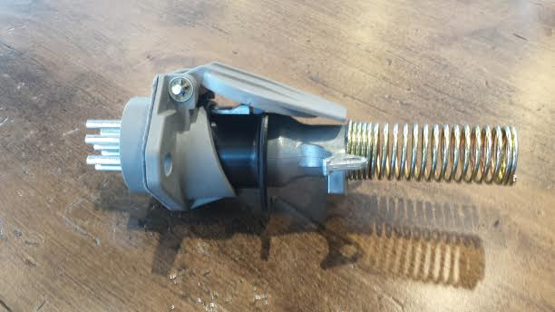
How the Shim Works

Slide 11
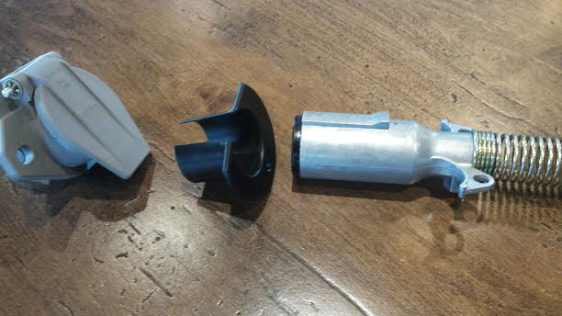
Step 1

Slide 12
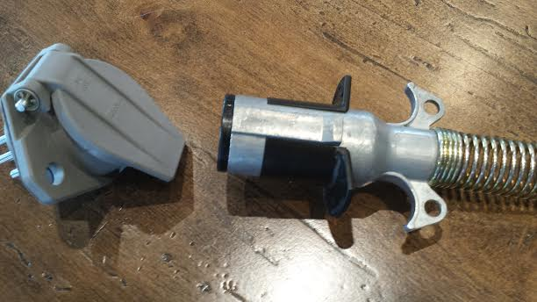
Step 2

Slide 13
Step 3

Slide 14
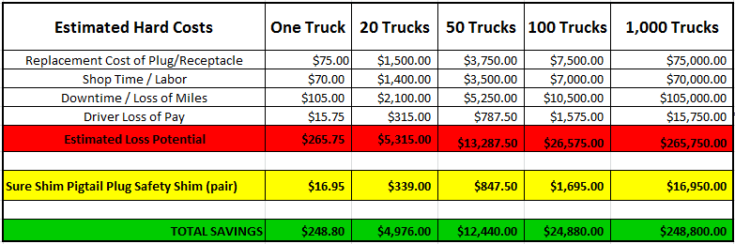
ESTIMATED COST SAVINGS

Slide 15
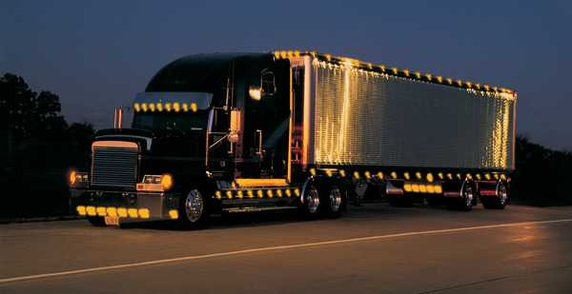
Be Smart…Be Safe…Be Seen!

